Slide 1
Assessing the Influence of Different Types of Probing on Adversarial Decision-Making in a Deception Game
Presenter:
Arif, Bryant Allsup, Joshua Zamora, Abu Sayed.

Slide 2
Topics
Problem Statement
Background Study
Task Description
Model
Result
Conclusion

Slide 3
Problem Statement
Cyber-attacks are increasing exponentially day by day. Thus, newer and effective techniques are needed to defend cyber infrastructures.
Deception method has proved itself worthwhile in this context. It involves using honeypots as decoy element
Although past researches involved the network size, proportion and configuration of honeypots in games there is a lack of work on evaluating the influence of probing action costs on adversarial decisions
Previous research done by Katakwar et al. investigates the impact of different cost functions in the probe stage on attacker decision-making

Slide 4
Problem Statement
In the paper ‘’Influence of probing action costs on adversarial decision-making in a deception game’’ they have introduced a Deception Game (DG) which involves an adversary attacking a network
In DG, n is the number of webservers, k is the number of honeypot webservers in the network, and γ is the number of probes an adversary could make before choosing to attack the network
Player (or adversary) can probe or not probe a webserver
Similarly, in the attack stage the player can attack or not attack a webserver
Adversary is awarded positive or negative points

Slide 5
Problem Statement
Three between-subject conditions that varied in the cost of probing actions included: increasing-cost (40 participants), constant-cost (40 participants), and no-cost (40 participants)
Though the work investigates the role of probing action costs on adversarial decisions, no cognitive model is introduced here
Therefore, we have developed a model which can play the role of an attacker and helps us better understand the adversarial decisions and its relation to probing cost

Slide 6
Background Study
Read “Influence of probing action costs on adversarial decision-making in a deception game published in Lecture Notes in Networks and Systems”
and “Sequential Decisions from Sampling: Inductive Generation of Stopping Decisions Using Instance-Based Learning Theory”

Slide 7
Task description
Our task is to create a model to accurately represent the human data found in the article “Influence of probing action costs on adversarial decision-making in a deception game published in Lecture Notes in Networks and Systems” through the use of ibl model.
This model will be attempting to show how a human would attack servers, given the info, that some are fake and some are real, while questioning whether the defender is lying to them or not.

Slide 8
Model
When starting the game there will be 4 servers,2 real and 2 fake(honeypot) servers.
in order to figure out if the servers are real or not the model splits decisions into 2 stages:
Probing: stage to analyze servers and determine if fake or real.
attacking: attack a single server to determine if it was real.
The probing stage is broken up further:
Deception Stage: defenders lie and say real servers are honeypot and honeypot servers are real.
Non-deception Stage: defenders reveal the actual identity of servers.

Slide 9
Model (Set up)
IBL model
Will consist of 3000 participants
Will be 30 rounds:
-15 Deception/15 non-deception rounds
-random sequence
4 servers: 2 fake servers (honeypots)/2 real servers
2 stages : 1 probing/1 attacking
We will also be incorporating Delayed feedback:at the end of each round the feedback is given to the attacker.

Slide 10
Model (Scoring)
Probing Stage
no Cost:
Probing a honeypot/regular server will not deduct or give points.
Not probing will not deduct points.
set cost:
Probing will cost -5 points for probing honeypot.
Probing will give +5 points for probing actual server.
Not probing will not deduct points.
incremental cost:
Probing will cost -5*i in a round for honeypot.(max -10)
Probing will give +5*i in a round for regular server.
Not probing will not deduct points.

Slide 11
Model (Scoring cont.)
Attacking Stage
after probing the attacker can choose to attack or withdraw.
Attacking a regular server is +10 points.
Attacking a honeypot is -10 points.
Not attacking will not deduct points.

Slide 12
Model (Defense)
Servers will be given a deception attribute
In deception rounds honeypots, when probed, are labeled regular servers and regular servers, when probed, are labeled honeypots.
In non-deception rounds servers when probed give their identity.
Round are not disclosed whether deception or non-deception round.

Slide 13
Model (Attacker)
Probing stage:
Attackers can choose to probe or not probe as many servers as they choose, before moving onto the attack stage.
Attacking stage:
Given one chance to either withdraw or attack any of the servers.

Slide 14
Process we Follow
Basic modeling
Not replicate work properly.
Delayed feedback
One action type(probe, attack)
Prepopulate values(+,-)
Prepopulate values(20->50)
Increase participant(1000)
Plot bar plot and line graph
Analysis of human data

Slide 15
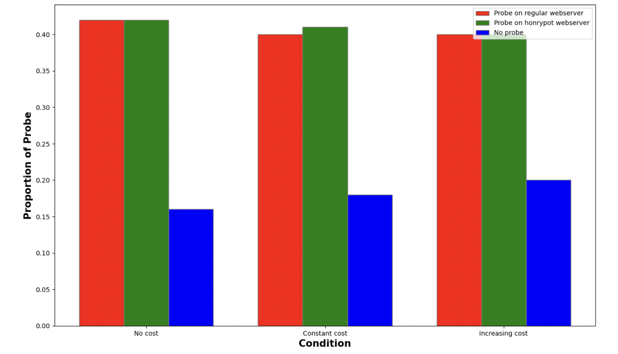
Result (Probe, model)

Slide 16
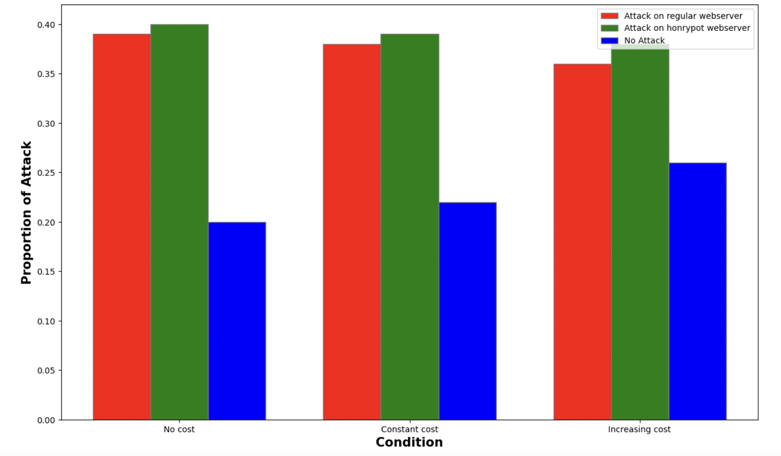
Result (Attack, model)

Slide 17
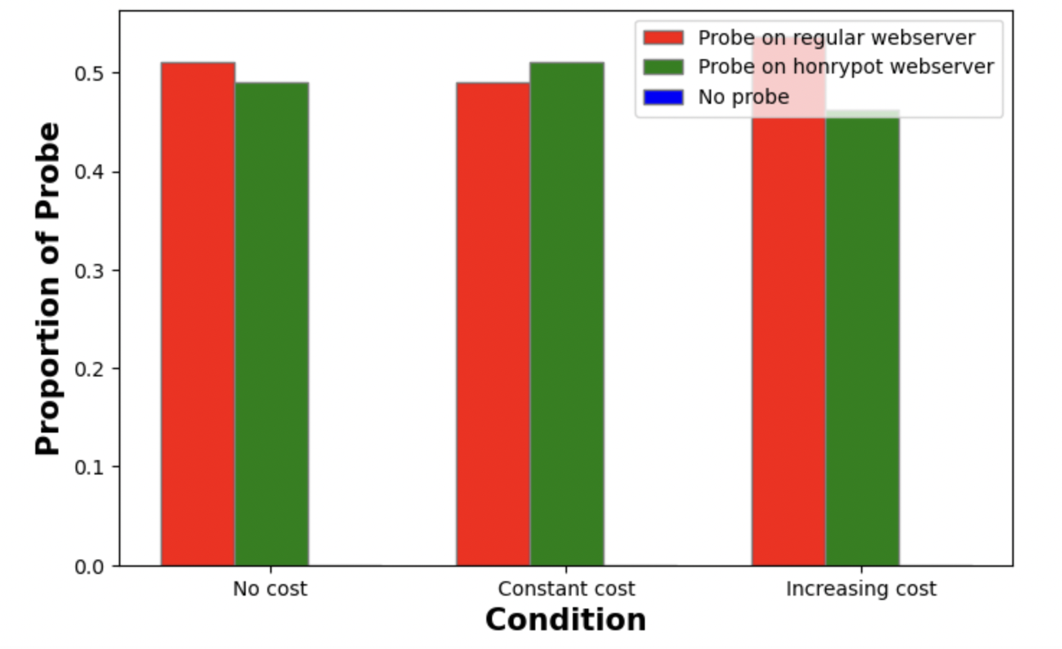
Result (Probe, human data)

Slide 18
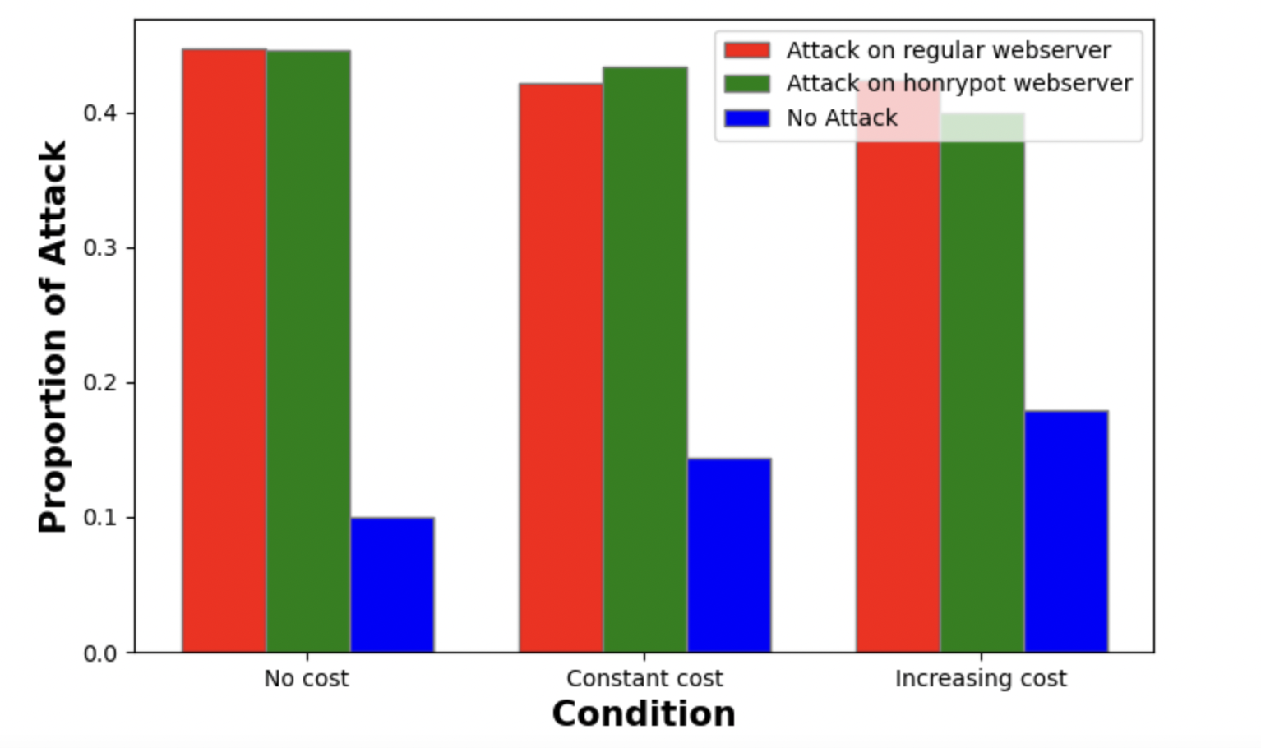
Result (Attack, human data)

Slide 19
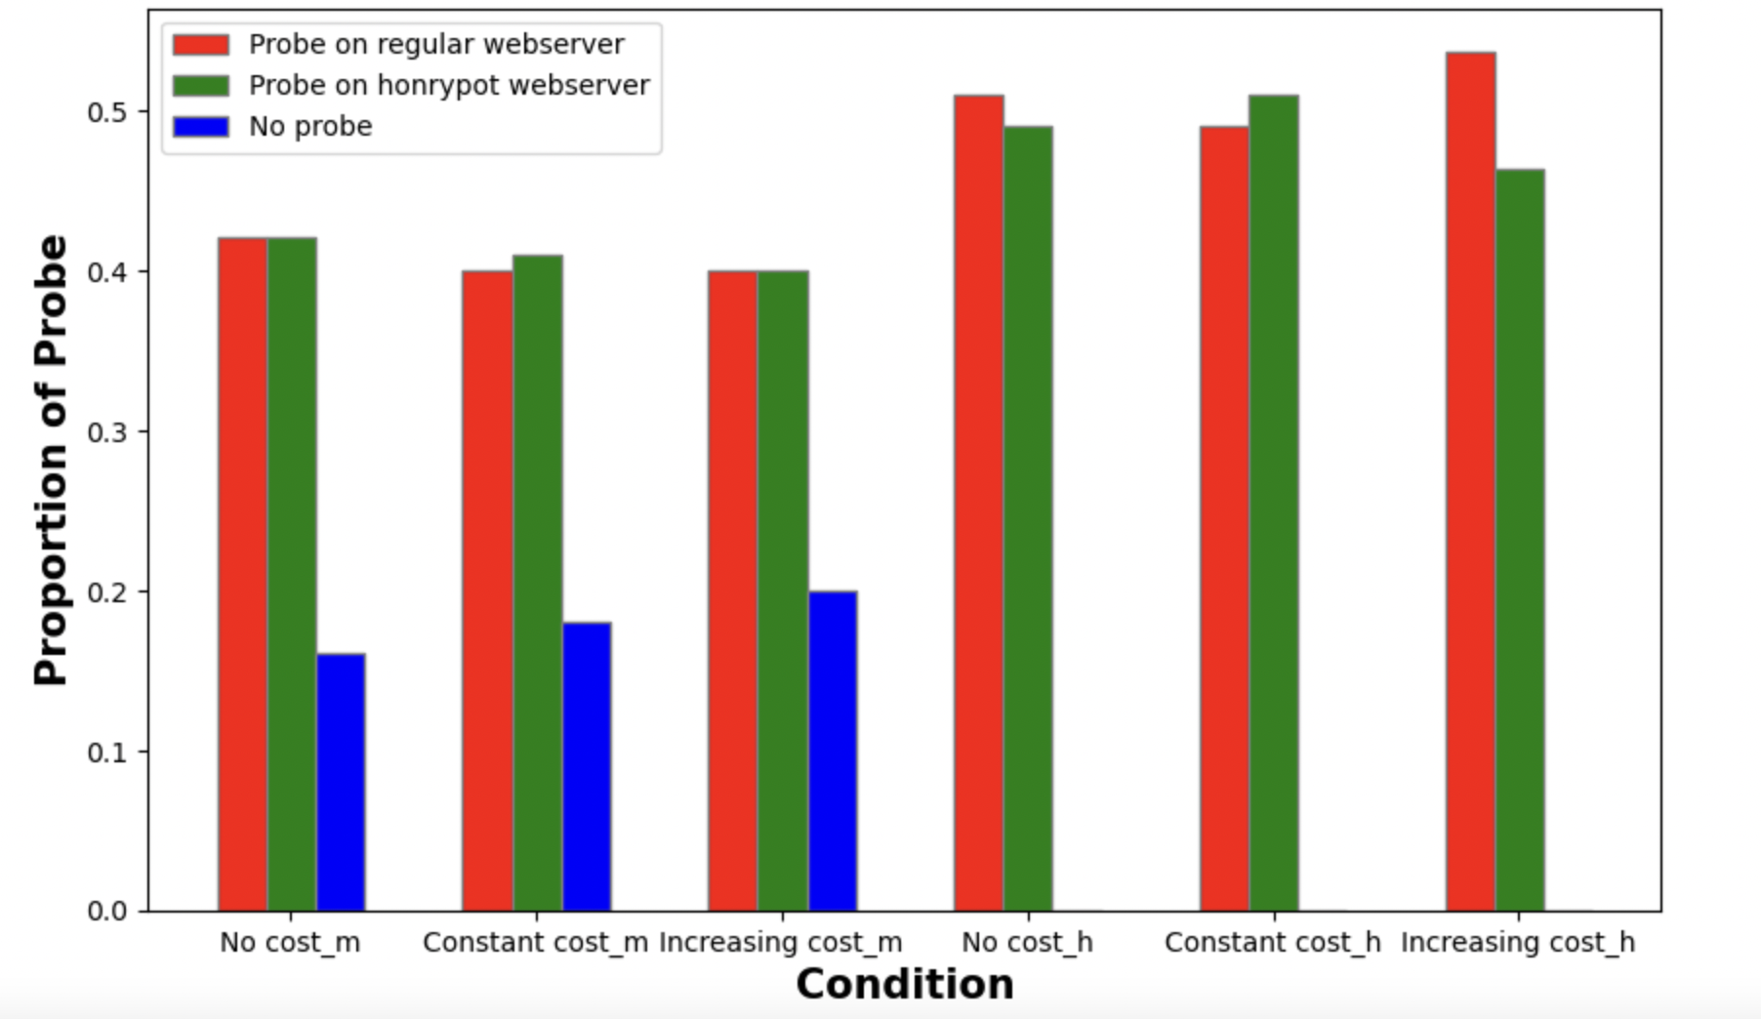
Result (Probe comparison)

Slide 20
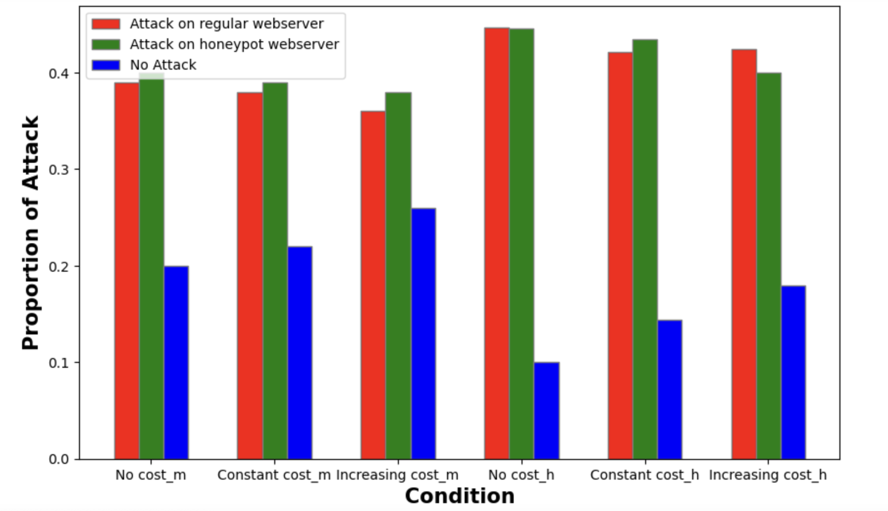
Result (Attack comparison)

Slide 21
Conclusion
Modeling.
Human data analysis.
Compare with human data.
Gap modeling.

Slide 22
Discussions & Questions

